Slide 1

UTA Logo on blue background

Slide 2
CSE 5335 - 002 Web Data Management
Professor: Elizabeth D. Diaz
Semester: Fall’22

Slide 3
INTRODUCTION
The Marketplace is an online business that caters to the needs of university students by providing them with e-commerce services.
There are four types of users:
Super Admins: who can manage all aspects of the site;
School Admins: who oversee activities at their respective schools;
Business Owners: who create and manage their business activities;
Students: who purchase items from stores on the site.

Slide 4
System Workflow Overview
The project system Marketplace is an e-commerce website that enables students to buy and sell products without having to visit a physical store.
A business can process orders, receive payments, handle shipping and logistics, and offer customer care service through the Marketplace website.
. Students who wish to utilize the features must first register because it is an e-commerce website.
One super admin will oversee all aspects of the website, including administrators from schools, business owners, and students.

Slide 5

TECHNOLOGIES USED

Slide 6
CODE BASE

Slide 7
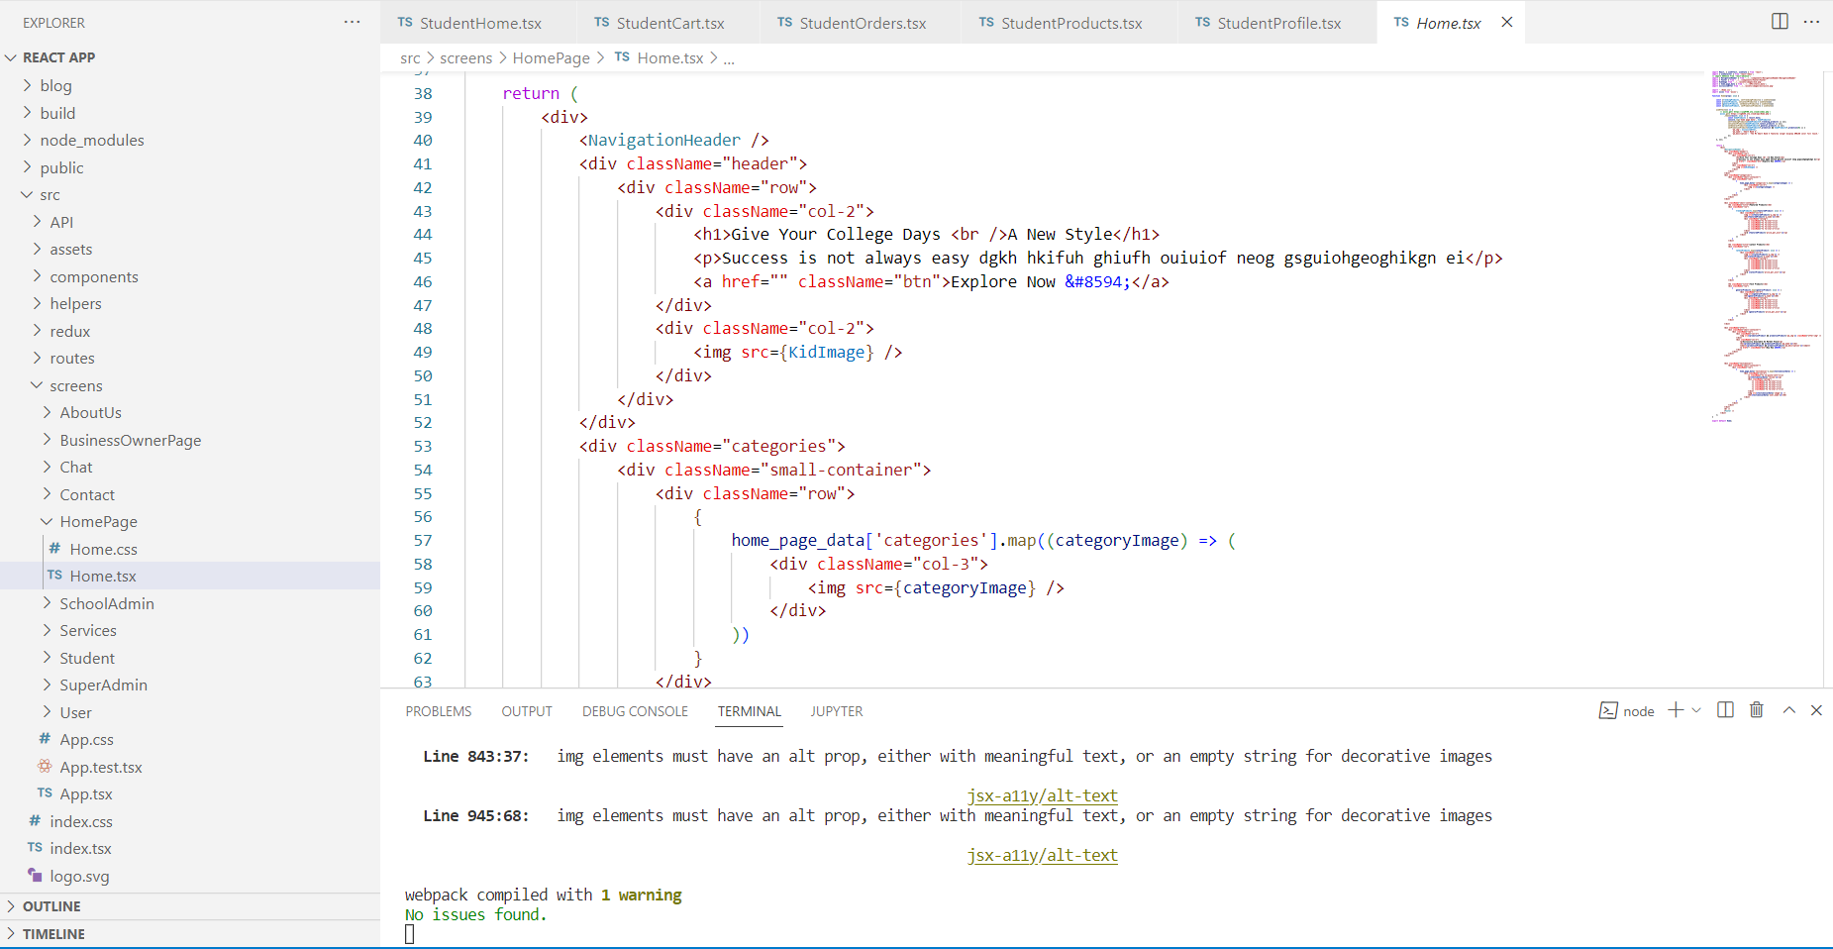
REACT-APP

Slide 8
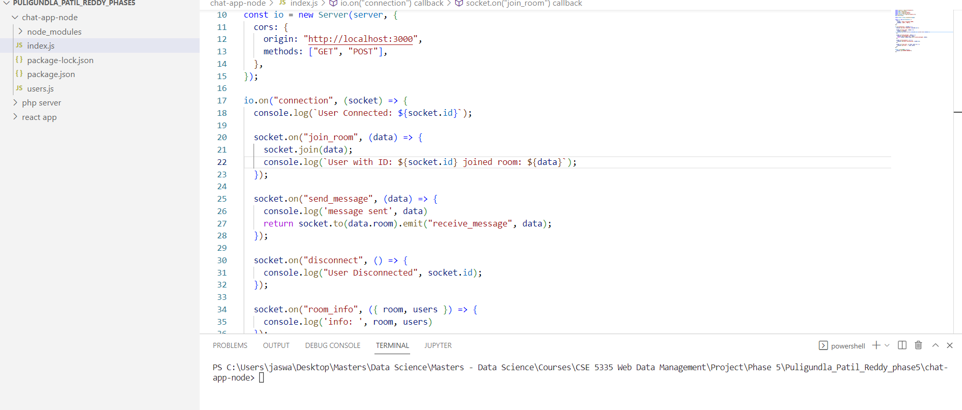
NODE-JS-CHAT-APP

Slide 9
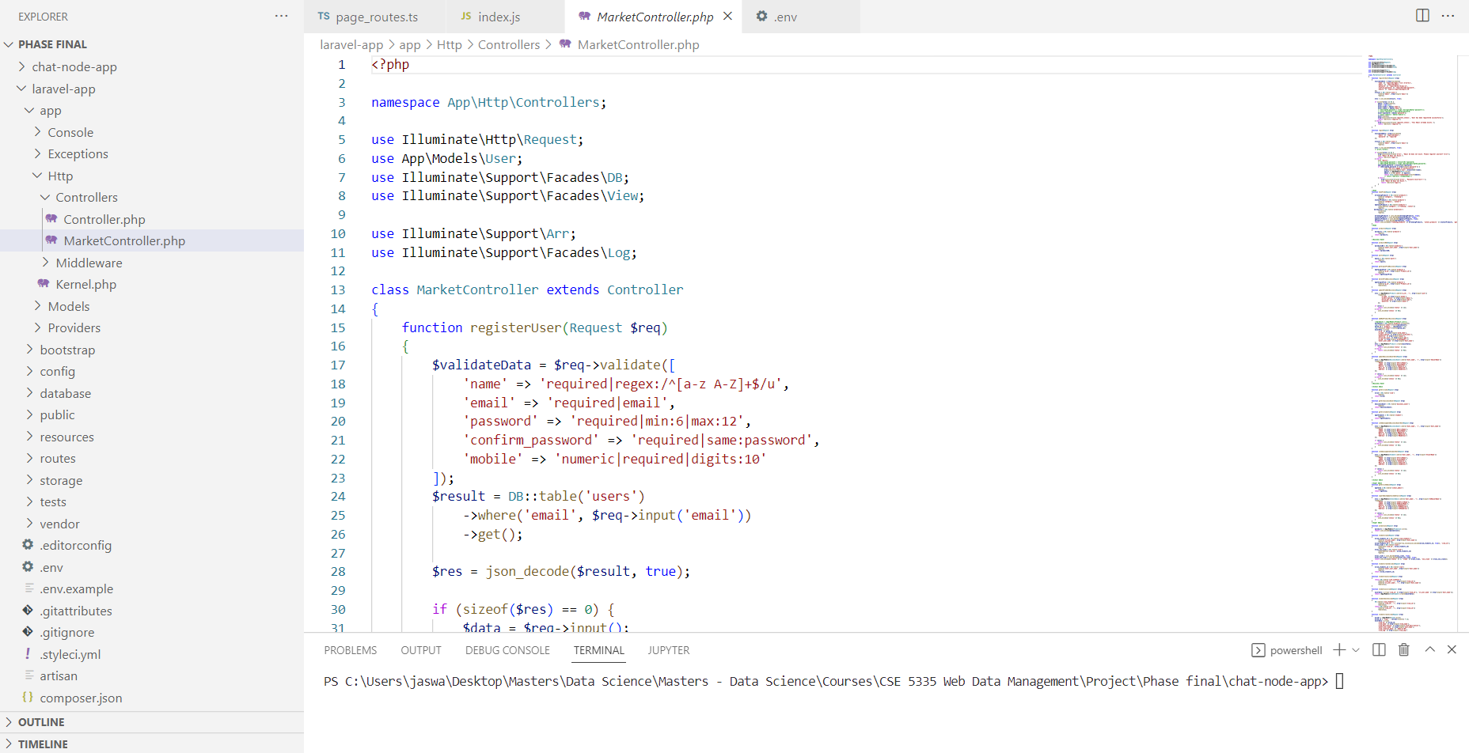
LARAVEL-APP

Slide 10
MARKET PLACE SITE MAP

Slide 11

HOME PAGE
This is the landing page of the Marketplace e-commerce site.
The home page has the following sections
category of products
Featured products
Latest product
Promotion section
User reviews

Slide 12
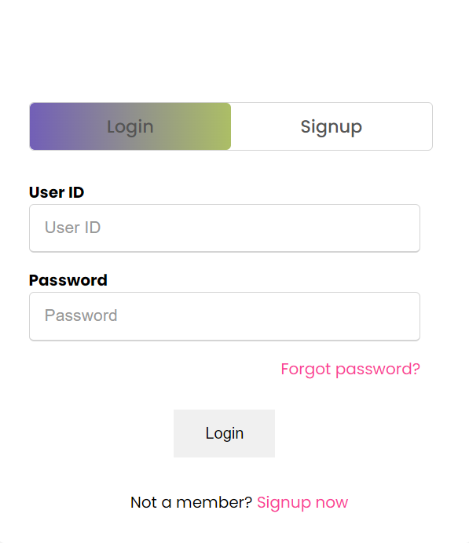
LOGIN PAGE
Allows the Marketplace existing users such as Students, Business Owners, Super Admins, or School Admins to sign into the Marketplace system.

Slide 13
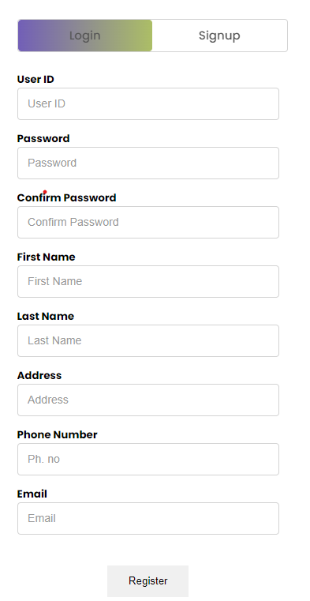
REGISTER PAGE
Any new customer to the Marketplace can signup in Marketplace by inputting the required details such as Username, Contact information, and Password.

Slide 14
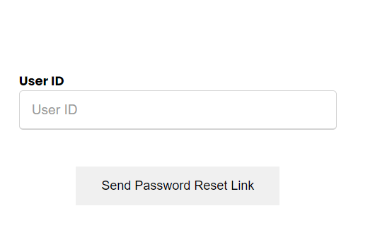
RESET PASSWORD PAGE
Existing customers can be able to reset their password by inputting their Username.
This generates an automated mail to the User communication mail to provide further instructions to reset the Password.

Slide 15
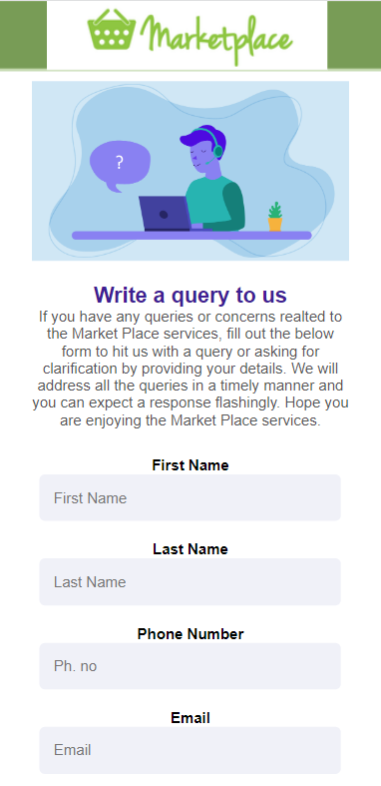
CONTACT US PAGE
Contact Us page provides a user with a form to submit any concerns/queries to the Super Administrator.
This page requires the user to give information about the user and the concern to submit the form to the Super Administrator.

Slide 16
SUPER ADMIN PAGE
Authority to manage all aspects of the Market Place
Features
Moderate Profile Section
Manage Business Owners
Manage School Admins
Manage Students
Reports and Insights
Chat functionality with Business owners

Slide 17
SCHOOL ADMIN PAGE
Authority to manage Students and Business owners of the Market Place
Features
Moderate Profile Section
Manage Business Owners
Manage Students
Reports and Insights
Chat functionality with Business owners

Slide 18
BUSINESS OWNER PAGE
Users who manage their business page on the website.
The main responsibility of the business owner is to manage the respective products, advertisements about their products, and offers.
Features
Moderate Profile section
Can add/edit/delete the product listing of the Business owners
Can add products by category
Moderate(edit/delete) posts
Chat functionality with customers

Slide 19
STUDENT PAGE
Users mainly use the website to buy/return products.
Features
New user creation as a student to keep track of the profile with the marketplace
Tracking of the orders by returning/replacing the received products
Re-ordering the previously ordered products
Can add the products to the cart to visit later for ordering any products
Payment page for buying the products without any need to visit the physical store
Can join or drop from clubs available
Can create or delete clubs
Can add/edit content through posts

Slide 20
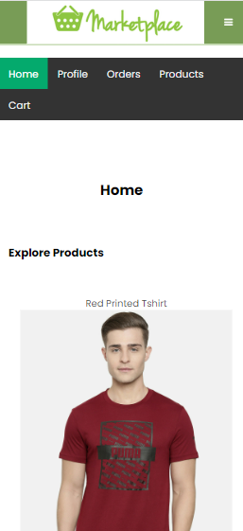
STUDENT PAGE (HOME)
This is the landing page of the Student Page
The Student home page has the following sections
Explore Products
Applicable promotions
Join/Leave clubs
Create/Delete clubs
Posts

Slide 21
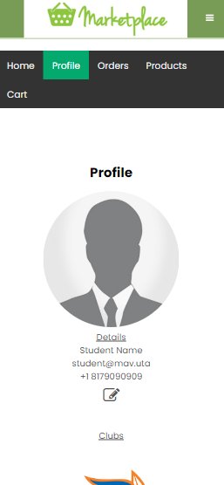
STUDENT PAGE (PROFILE)
The Student Profile page has the following sections
Student details
Clubs (which a student is part of)
Posts created by the student

Slide 22
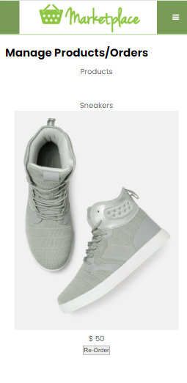
STUDENT PAGE (ORDERS)
The Student Orders page has the following functionality
Re-order products
Track products
Return products

Slide 23
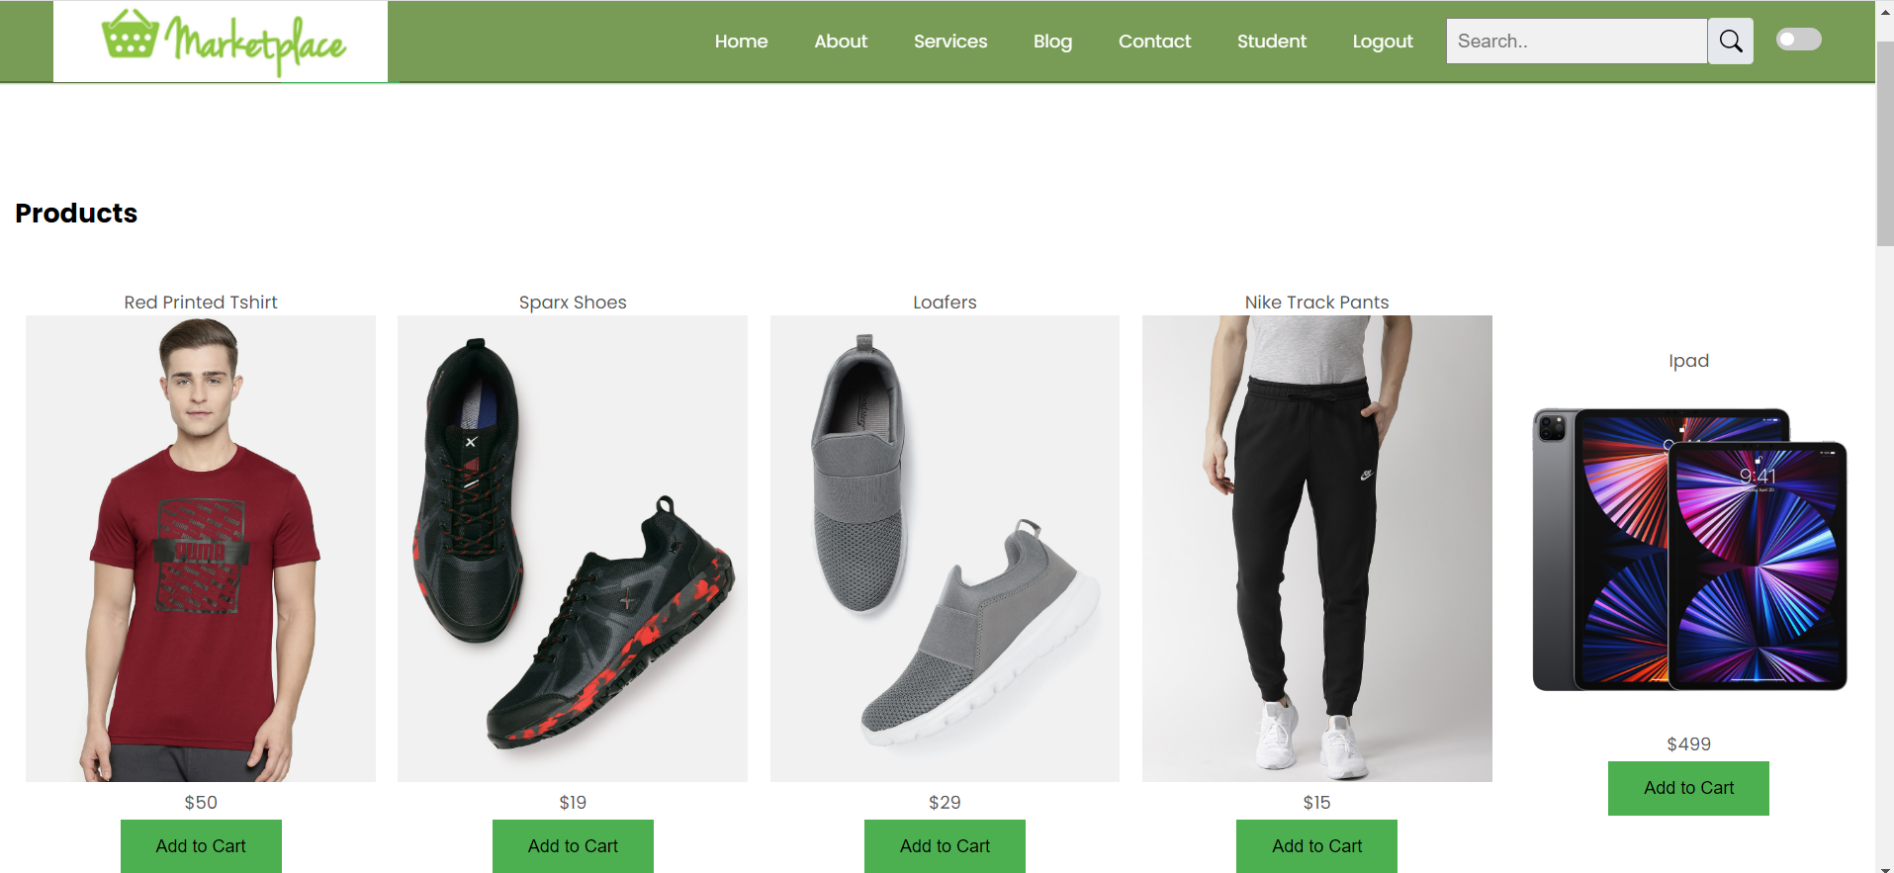
STUDENT PAGE (PRODUCTS)
Student products page has a list of products to add to the Student cart

Slide 24
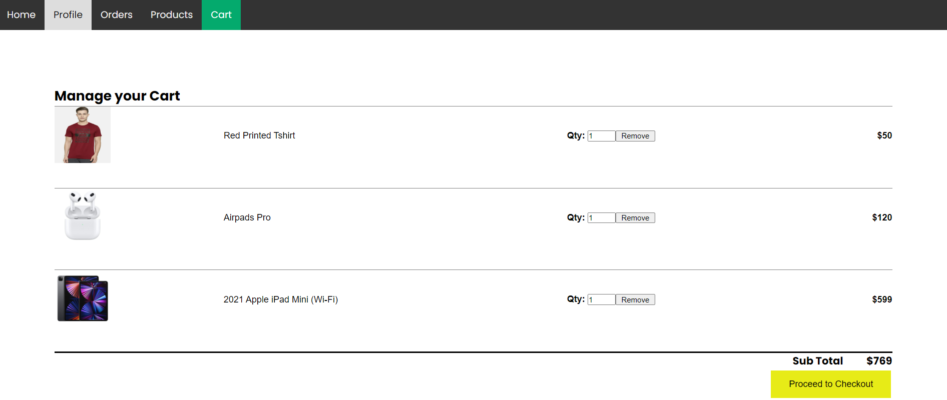
STUDENT PAGE (CART)
Student cart page has a list of products which a student wish to buy
Students can update product count in the Cart page
Proceed to Checkout enables student to navigate to the Payment page

Slide 25
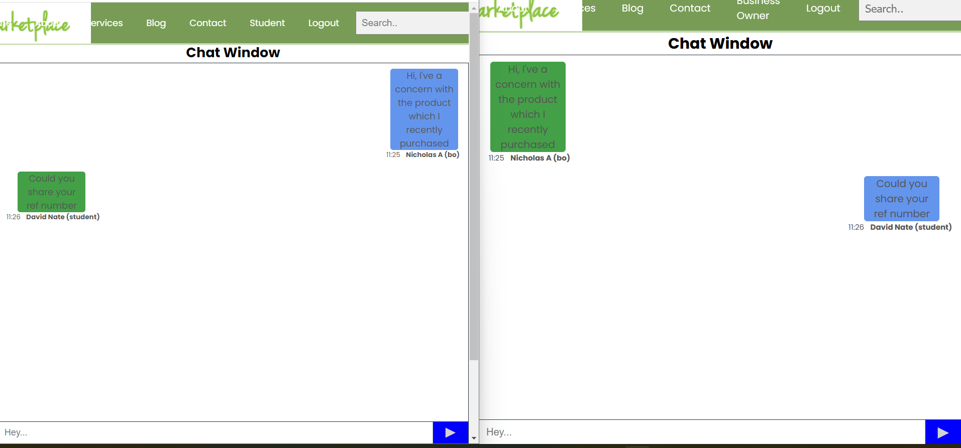
CHAT PAGE

Slide 26

ABOUT US PAGE
Provides the information and purpose of the Market Place. Shows some insights into the Market Place.

Slide 27
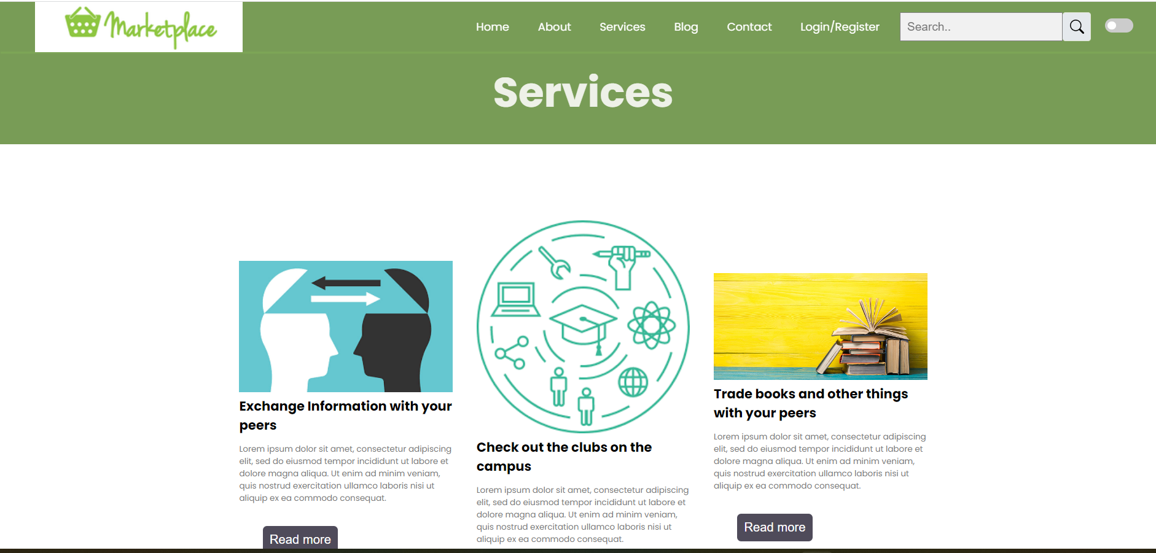
SERVICES PAGE
Detailed lists of all the services available on the Market Place e-commerce site.

Slide 28
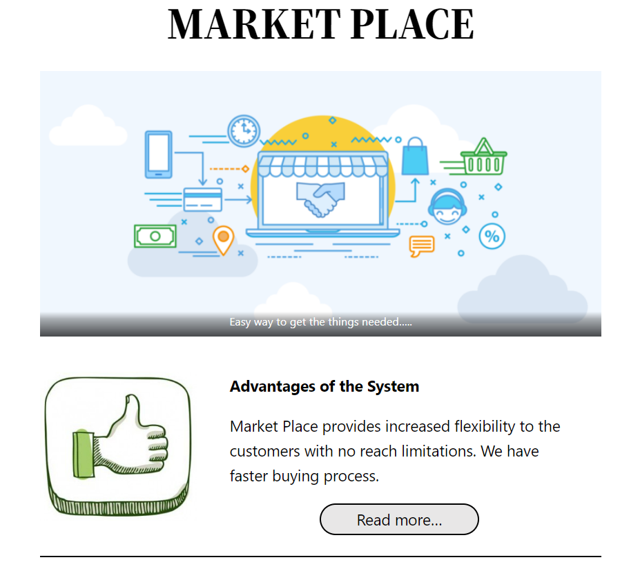
BLOG PAGE
The blog page has additional information about the marketplace in all prospects with a detailed view of the services, challenges, and Improvement areas

Slide 29
INFLUENCE/RELEVANCE OF THE CLASS LECTURES
Customizing the Request headers for making API calls
HTML element structuring with the different HTML elements such as header tags, Paragraph tags, Media elements, list elements, Hyperlinks
Styling HTML elements with the CSS selectors
Data representation with Tables and submission with Forms
CSS effects for animation
Media Queries to design respective screens for the Mobile/Desktop/Tablet resolutions
React framework concepts such as routes, state management, component design
Database connection with PHP (Laravel) code
Node.js architecture
Database design and development

Slide 30
WHAT WOULD HAVE DONE BETTER:
Improved API calls latency by making concurrent requests
Page performance by efficiently rendering react components
More efficiently handling Page Redirections, Client-side errors, Server-side errors
More animations to make the website more user friendly
Increase handling heavy user traffic

Slide 31
CHALLENGES
Codebase management
Virtual team meetings
Meeting deadlines for the phases was difficult as we had to learn and implement unknown concepts
Each team member’s technical expertise was different

Slide 32
CONCLUSION
The Marketplace helps students with e-commerce services and allows customers to interact with product owners virtually with ease. This makes customers purchasing easier and can allow them to order at any time.

Slide 33
THANK YOU

